Slide 1
Wazuh
(CSE406 - Term Project)
Supervisor: Abdur Rashid Tushar (Lecturer, Dept of CSE, BUET)
Students: Mohammad Sadat Hossain (1905001)
Asif Azad (1905004)
Md. Ashrafur Rahman Khan (1905005)
Date: 07.03.2024

Slide 2
Introduction

Slide 3
What is Wazuh?
Wazuh is:
an open-source security monitoring platform
that provides XDR (Extended Detection and Response)
and SIEM (Security Information and Event Management) facilities
It builds upon the capabilities of OSSEC (Open Source HIDS SECurity), which is also an open-source Host-based Intrusion Detection System (HIDS),
and enhances its functionalities with additional features, richer APIs, and improved integration capabilities.

Slide 4
Wazuh Components
Wazuh Agents
Installed on endpoints one wishes to monitor.
Wazuh Manager
Wazuh Server
Receives, analyzes and correlates data received from Agents. Updates and manages Agents too.
Wazuh Indexer
Indexes and stores alerts generated by the Wazuh server.
Wazuh Dashboard
Web UI for visualizing data monitored and analyzed.

Slide 5
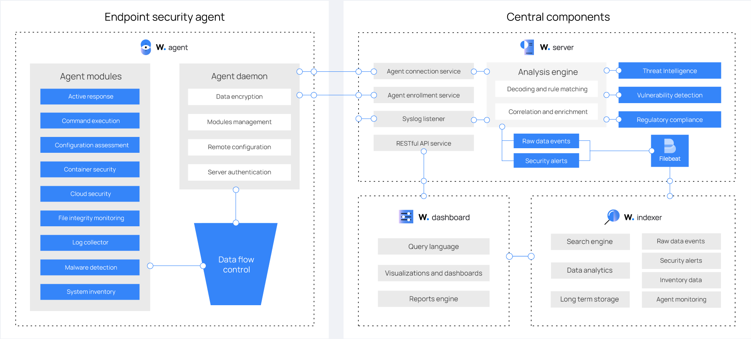

Slide 6
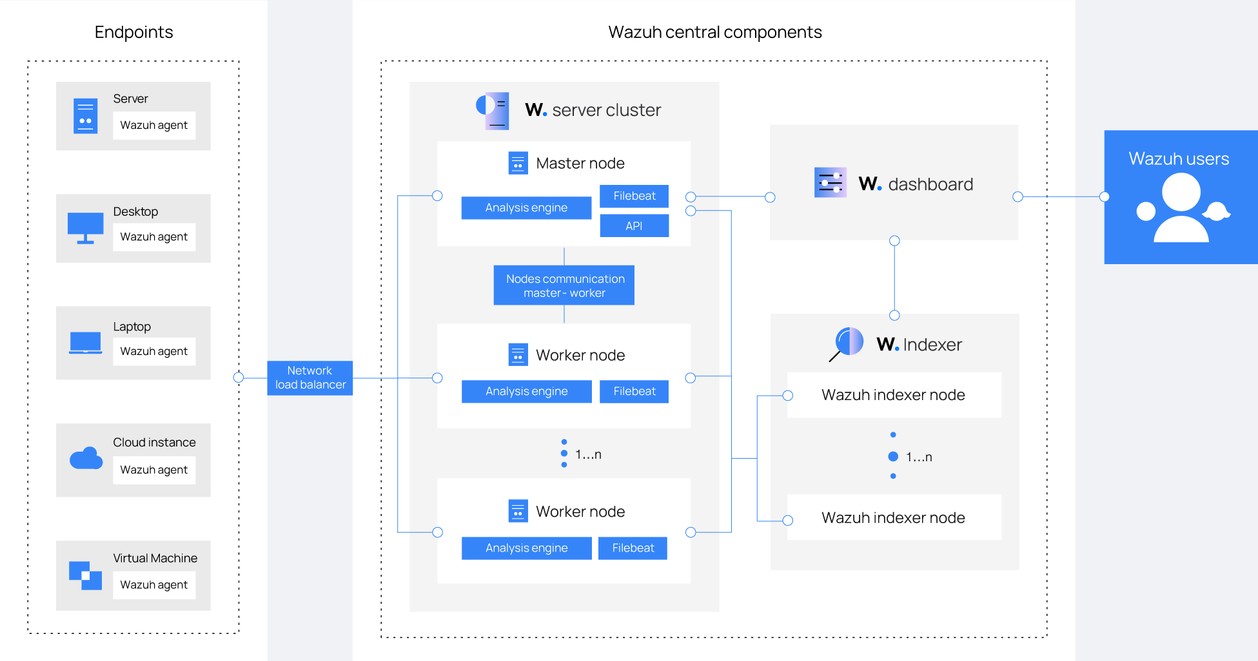
Wazuh Architecture

Slide 7
Wazuh Use-Cases
Configuration Assessment
Malware Detection
File Integrity Monitoring
Threat Hunting
Log Data Analysis
Malware Detection
Vulnerability Detection
Incident Response
Regulatory Compliance
IT Hygiene
Container Security
Posture Management
Workload Protection

Slide 8
Wazuh Use-Cases
Configuration Assessment
Malware Detection
File Integrity Monitoring
Threat Hunting
Log Data Analysis
Malware Detection
Vulnerability Detection
Incident Response
Regulatory Compliance
IT Hygiene
Container Security
Posture Management
Workload Protection

Slide 9
Wazuh Use-Cases
Configuration Assessment
Malware Detection (Demonstrate)
File Integrity Monitoring (Demonstrate)
Threat Hunting
Log Data Analysis
Malware Detection
Vulnerability Detection
Incident Response
Regulatory Compliance
IT Hygiene
Container Security
Posture Management
Workload Protection

Slide 10
Diversified Agent Connection

Slide 11
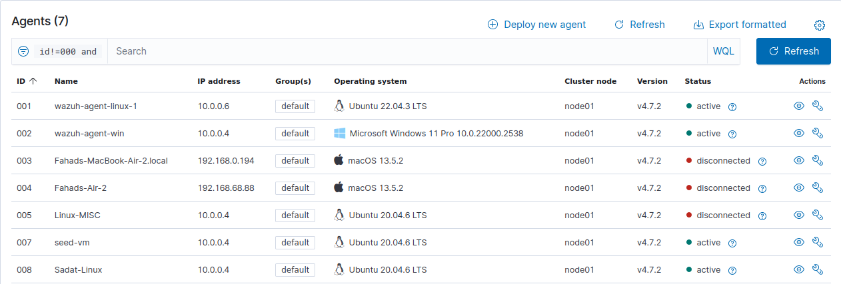
Agents using any and all kinds of Operating System can connect to the manager.

Slide 12
Feature Demonstration: File Integrity Monitoring

Slide 13
File Integrity Monitoring
Using Wazuh, we can monitor the integrity of files. This can have many different use cases like:
Malware Persistence Detection
Account Manipulation Detection
Periodic monitoring of Files
Reporting File Changes
Monitoring Configuration Change

Slide 14
File Integrity Monitoring
Using Wazuh, we can monitor the integrity of files. This can have many different use cases like:
Malware Persistence Detection
Account Manipulation Detection (Demonstrate)
Periodic monitoring of Files
Reporting File Changes
Monitoring Configuration Change (Demonstrate)

Slide 15
File Integrity Monitoring: Account Manipulation Detection

Slide 16
Account Manipulation Detection (Basics)
Adversaries can alter the SSH authorized_keys file in Linux, which is contained in the .ssh directory within a user home directory.
For a user named john, the authorized_keys file is at /home/john/.ssh/authorized_keys.
This file defines the public keys this user uses to login into some of their accounts.
Wazuh FIM module can be configured to monitor the authorized_keys file.
This triggers an alert whenever a user or process modifies the public keys in the file.
Detecting the modification of the SSH keys allows you to take action before a system compromise occurs.

Slide 17
Account Manipulation Detection
Edit the /var/ossec/etc/ossec.conf configuration file and add authorized_keys for monitoring:
<syscheck>
<directories whodata="yes">/home/*/.ssh/authorized_keys</directories>
</syscheck>
Restart the Wazuh agent to apply the configuration.
systemctl restart wazuh-agent

Slide 18
Testing: Account Manipulation Detection
Generate an SSH key-pair for user authentication and save it as .ssh/test_key using the following command:
ssh-keygen -f .ssh/test_key
Run the following command to copy the content of the generated SSH public key test_key.pub and add it to the authorized_keys file in the target Ubuntu user .ssh directory:
cat ~/.ssh/test_key.pub | ssh <UBUNTU_USER>@<UBUNTU_IP> "sudo tee -a /home/<UBUNTU_USER>/.ssh/authorized_keys"
Here, the <UBUNTU_USER> and <UBUNTU_IP> placeholders are to be filled with the appropriate values respectively.

Slide 19
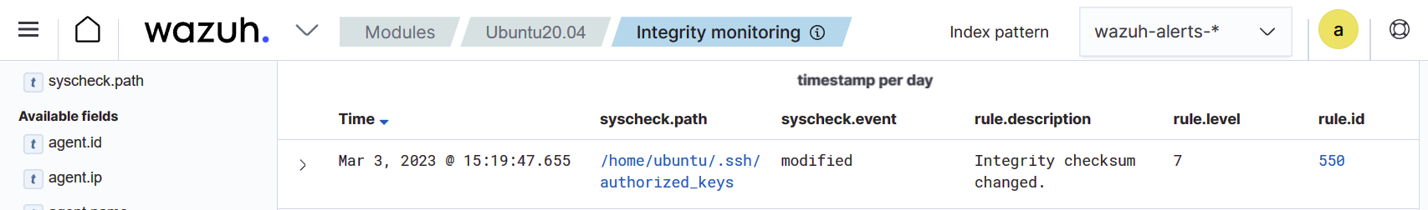
Testing: Account Manipulation Detection
Navigate to Modules > Integrity monitoring on the Wazuh dashboard to view the alert generated when the FIM module detects changes to the authorized_keys file.

Slide 20
File Integrity Monitoring: Configuration Change Monitoring

Slide 21
Configuration Change Monitoring (Basics)
The FIM module can be configured to monitor configuration files and report any changes.
The module uses the whodata and report_changes attributes to record the following information about such changes:
The login user that made the changes.
The time of the changes.
The process that the user executed.
The changes made to the file.

Slide 22
Configuration Change Monitoring
Create a file app.conf in the /etc directory:
touch /etc/app.conf
Edit the /var/ossec/etc/ossec.conf configuration file and add the configuration below:
<syscheck>
<directories check_all="yes" report_changes="yes" whodata="yes">/etc/app.conf</directories>
</syscheck>
Restart the Wazuh agent to apply the configuration changes:
systemctl restart wazuh-agent

Slide 23
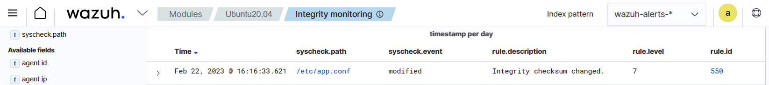
Testing: Configuration Change Monitoring
Modify the /etc/app.conf file by using nano with root privilege:
nano /etc/app.conf
Add <anything> to the file and save.
Navigate to Modules > Integrity monitoring on the Wazuh dashboard to view the alert generated when the FIM module detects modification of the configuration file.

Slide 24
Feature Demonstration: Malware Detection

Slide 25
Malware Detection (Basics)
Malware detection refers to
the process of analyzing a computer system or network
for the existence of malicious software and files
Detection methods include:
checking for signatures of known malware
detecting suspicious behavior from software activity

Slide 26
How Wazuh detects Malware
In conjunction with File Integrity Management Module (FIM)
YARA scans (Demonstrate)
CDB (Centralized Databases) lists with file hashes (Demonstrate)
CTI sources like Virustotal
Anomaly Detection with Rootcheck Module:
Continuously monitors endpoints
Generates alerts when anomaly detected
Ensures security even if signature based searching fails
Other ways:
Windows Defender logs collection

Slide 27
Malware Detection:
YARA Scanning

Slide 28
YARA:
YARA is an open source tool that identifies and classifies malware artifacts based on textual or binary patterns.
These patterns are indicators found in malware samples and are defined in the YARA rules file.
The YARA community updates the YARA rules file to include newly discovered malware signatures.

Slide 29
How it works:
(In agent) FIM scans directories to detect file creation/ Modification (generate alert for an event). FIM stores checksums, hashes and attributes of the monitored files
Upon an alert from FIM, (in Server) it triggers a YARA scan active response. The active response module automatically executes YARA using the yara.sh script. YARA then scans the file that triggered the FIM alert against its ruleset to determine whether it is malware.
When the YARA rules match a file, the scan results are forwarded to the Wazuh manager for decoding, analysis and alerting. Custom decoders are to be added to the Wazuh server.

Slide 30
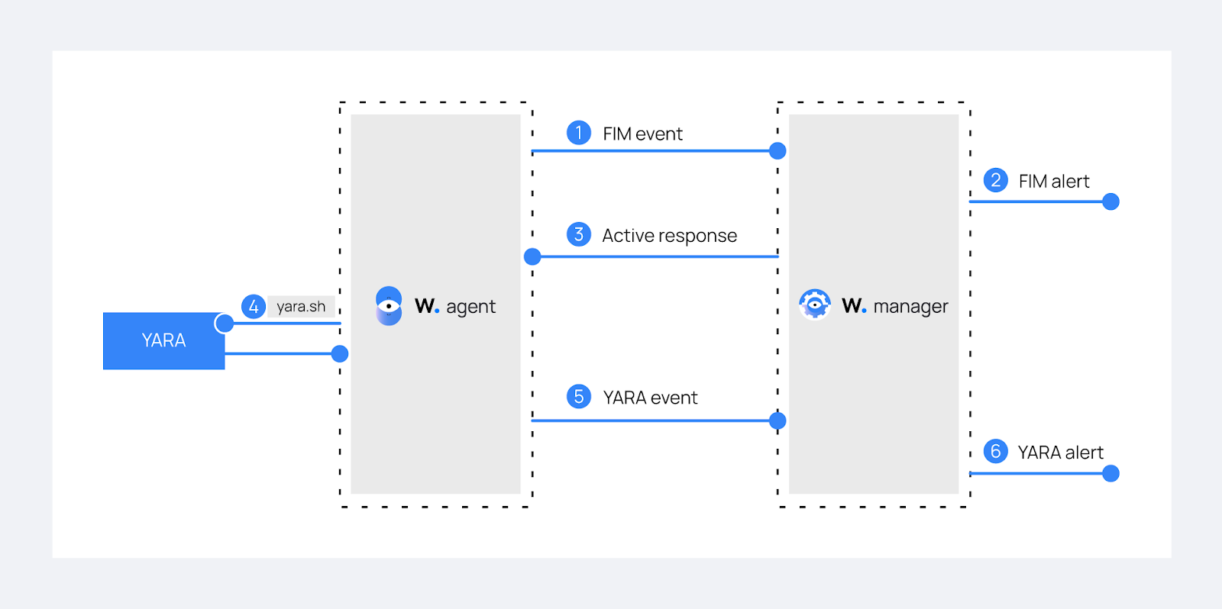
Flow of Events:

Slide 31
Detecting Malware on Linux endpoints using YARA
On Agent:
Download, compile and install YARA:
sudo apt update
sudo apt install -y make gcc autoconf libtool libssl-dev pkg-config
sudo curl -LO https://github.com/VirusTotal/yara/archive/v4.2.3.tar.gz
sudo tar -xvzf v4.2.3.tar.gz -C /usr/local/bin/ && rm -f v4.2.3.tar.gz
cd /usr/local/bin/yara-4.2.3/
sudo ./bootstrap.sh && sudo ./configure && sudo make && sudo make install && sudo make check
2. Running yara should ask you for arguments now.

Slide 32
Detecting Malware on Linux endpoints using YARA
3. Download YARA detection rules:
sudo mkdir -p /tmp/yara/rules
sudo curl 'https://valhalla.nextron-systems.com/api/v1/get' \
-H 'Accept: text/html,application/xhtml+xml,application/xml;q=0.9,*/*;q=0.8' \
-H 'Accept-Language: en-US,en;q=0.5' --compressed \
-H 'Referer: https://valhalla.nextron-systems.com/' \
-H 'Content-Type: application/x-www-form-urlencoded' \
-H 'DNT: 1' -H 'Connection: keep-alive' -H 'Upgrade-Insecure-Requests: 1' \
--data 'demo=demo&apikey=1111111111111111111111111111111111111111111111111111111111111111&format=text' \
-o /tmp/yara/rules/yara_rules.yar

Slide 33
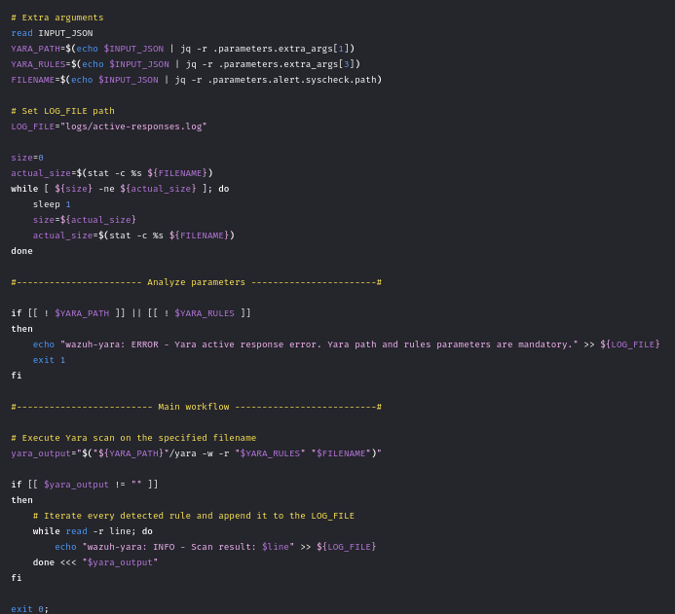
Detecting Malware on Linux endpoints using YARA
4. Create a yara.sh script in the /var/ossec/active-response/bin/ directory:

Slide 34
Detecting Malware on Linux endpoints using YARA
5. Change yara.sh file owner to root:wazuh and file permissions to 0750:
sudo chown root:wazuh /var/ossec/active-response/bin/yara.sh
sudo chmod 750 /var/ossec/active-response/bin/yara.sh
6. Add the following within the <syscheck> block of the Wazuh agent /var/ossec/etc/ossec.conf configuration file to monitor the /tmp/yara/malware directory:
<directories realtime="yes">/tmp/yara/malware</directories>
7. Restart the Wazuh agent to apply the configuration changes:
sudo systemctl restart wazuh-agent

Slide 35
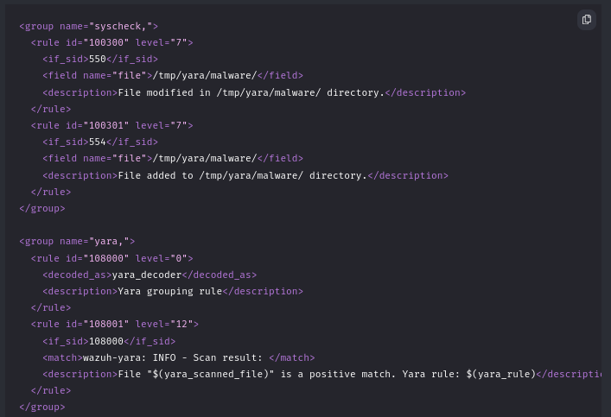
Detecting Malware on Linux endpoints using YARA
On Server:
Add the following rules to the /var/ossec/etc/rules/local_rules.xml file. The rules detect FIM events in the monitored directory. They also alert when the YARA integration finds malware.

Slide 36
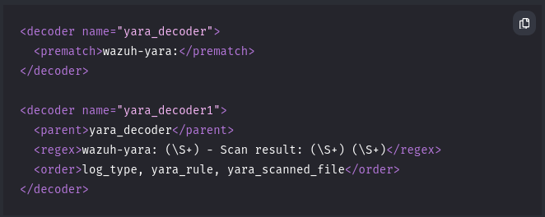
Detecting Malware on Linux endpoints using YARA
2. Add the following decoders to the Wazuh server /var/ossec/etc/decoders/local_decoder.xml file. This allows extracting the information from YARA scan results:

Slide 37
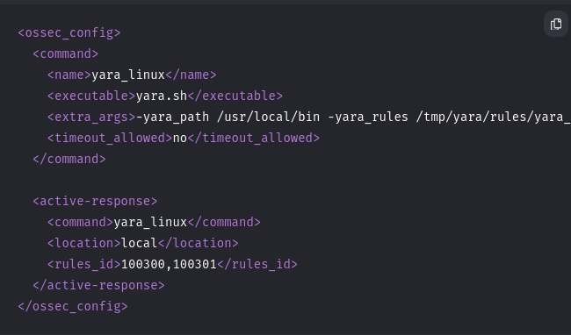
Detecting Malware on Linux endpoints using YARA
3. Add the following configuration to the Wazuh server /var/ossec/etc/ossec.conf configuration file. This configures the active response module to trigger after the rule 100300 and 100301 are fired:
4. Restart the Wazuh manager to apply the configuration changes: sudo systemctl restart wazuh-manager

Slide 38
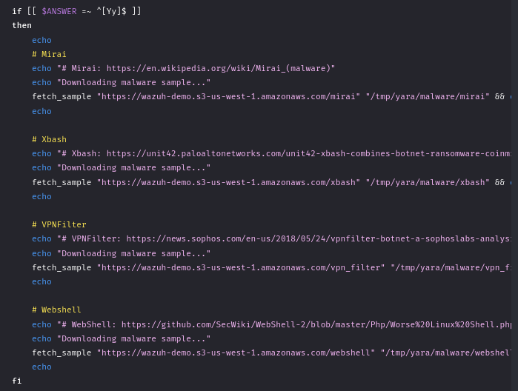
Attack Emulation: Malware Detection using YARA Scan
Create the script /tmp/yara/malware/malware_downloader.sh on the monitored endpoint to download malware samples:

Slide 39
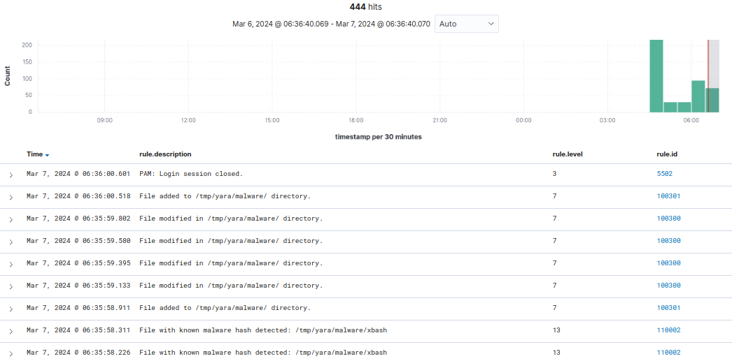
Attack Emulation: Malware Detection using YARA Scan
2. Run the malware_downloader.sh script to download malware samples to the /tmp/yara/malware directory:
sudo bash /tmp/yara/malware/malware_downloader.sh

Slide 40
Malware Detection:
CDB Lists & Threat Intelligence

Slide 41
CDB Lists:
A CDB list is a text file that can be used to save a list of users, file hashes, IP addresses, and domain names.
One can add entries to a CDB list in key:value pairs or key: only.
CDB lists can act as either allow or deny lists.

Slide 42
How it works:
Wazuh checks if field values, such as IP address, file hashes, and others, extracted from security events during decoding are in a CDB list to hunt and detect malware.
The Wazuh FIM module scans monitored directories on endpoints to detect changes such as file creation and modifications. The FIM module stores the checksums and attributes of the monitored files.
When the FIM module generates an alert, the Wazuh analysis engine compares the file attributes, for example, the file hash, to the keys in a predefined CDB list.
If the Wazuh analysis engine finds a match, it generates or suppresses an alert based on how you configure your rule.

Slide 43
Detecting Malware on Linux endpoints using CDB
On Server:
Create a CDB list malware-hashes of known malware hashes and save it to the /var/ossec/etc/lists directory on the Wazuh server.
vi /var/ossec/etc/lists/malware-hashes
Add the known malware hashes to the file as key:value pairs. In this case, the known MD5 hashes of the Mirai and Xbash malware can be used as shown below:
e0ec2cd43f71c80d42cd7b0f17802c73:mirai
55142f1d393c5ba7405239f232a6c059:Xbash

Slide 44
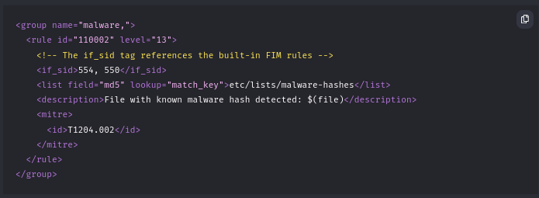
Detecting Malware on Linux endpoints using CDB
3. Add a reference to the CDB list in the Wazuh manager configuration file /var/ossec/etc/ossec.conf. This can be done in this way:
```
<list>etc/lists/malware-hashes</list>
```
4. Create a custom rule in the /var/ossec/etc/rules/local_rules.xml file on the Wazuh server. The rule generates alerts when the Wazuh analysis engine matches the MD5 hash of a new or modified file to a hash in the CDB list.

Slide 45
Detecting Malware on Linux endpoints using CDB
5. Restart the Wazuh manager to apply changes.
systemctl restart wazuh-manager

Slide 46
Detecting Malware on Linux endpoints using CDB
On Client:
Configure directory monitoring by adding the <directories> block specifying the folders you want to monitor in the agent configuration file or using the centralized configuration option.
<ossec_config>
<syscheck>
<disabled>no</disabled>
<directories check_all="yes" realtime="yes">/home/seed/fim</directories>
</syscheck>
</ossec_config>
Restart the agent to apply the changes.

Slide 47
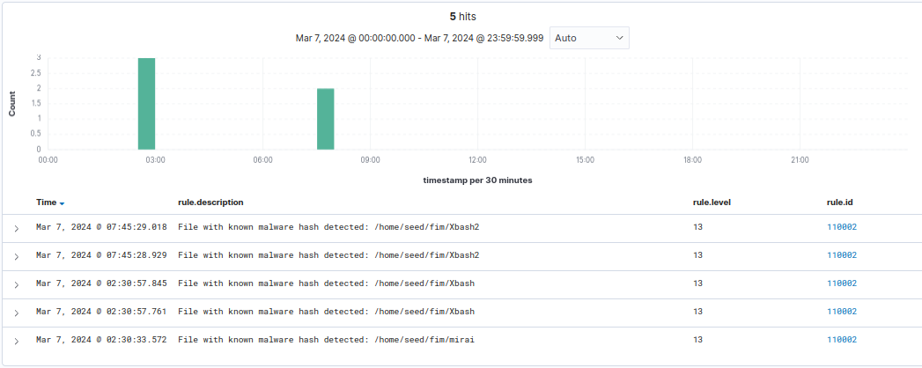
Attack Emulation: Malware Detection using CDB
Download the malware samples.
sudo curl https://wazuh-demo.s3-us-west-1.amazonaws.com/mirai --output /home/seed/fim/mirai
sudo curl https://wazuh-demo.s3-us-west-1.amazonaws.com/xbash --output /home/seed/fim/Xbash

Slide 48
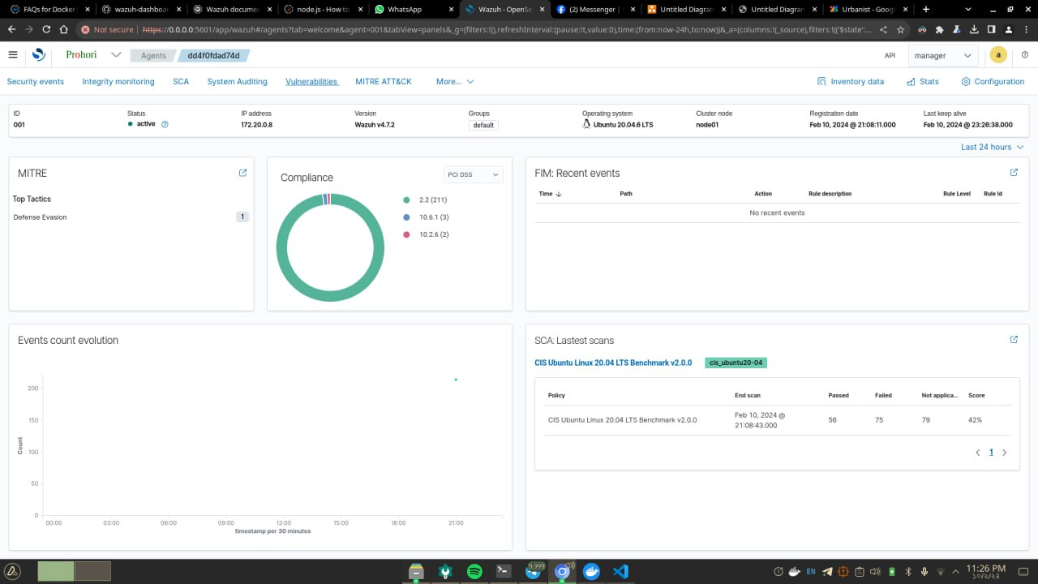
Tinkering the Source Code
As you can see, the dashboard no more contains the name “Wazuh”.

Slide 49
Thank You!!!

